Slide 1
STUDENT NAME: S. SAI SUBRAMANIAN
REGISTER NO: 962821104301
E-MAIL ID : saisubramanian3210@gmail.com
FINAL PROJECT

Slide 2
PROJECT TITLE
TextGen: AI-Powered Text Generation System

Slide 3
AGENDA
Introduction
Problem Statement
Project Overview
Who are the End Users
Solution and Value Proposition
The Wow in Our Solution
Modelling
Results

Slide 4
PROBLEM STATEMENT:
Text generation tasks, such as creating short stories, poems, or news articles, often require substantial time and creativity.
Human-generated content can be subjective, and it may not always meet the desired quality standards.
There is a need for an automated text generation system that can produce realistic and high-quality content across various genres.

Slide 5
PROJECT OVERVIEW:
Our project aims to develop an AI-powered text generation system capable of creating realistic text, including short stories, poems, and news articles.
Leveraging state-of-the-art machine learning techniques, our system will analyze and learn from a diverse dataset of text to generate coherent and contextually appropriate content.
Users will be able to specify the genre, style, and length of the text they want to generate, and the system will produce tailored content accordingly.

Slide 6
WHO ARE THE END USERS?
Writers, journalists, and content creators seeking inspiration or assistance in generating text for their projects.
Educators and students looking for tools to aid in creative writing exercises or language learning activities.
Businesses in need of automated content generation for marketing campaigns, chatbots, or customer engagement.

Slide 7
SOLUTION AND ITS VALUE PROPOSITION
Our solution, TextGen, offers a user-friendly interface where users can easily input their preferences and receive generated text tailored to their needs.
By harnessing the power of AI and machine learning, TextGen accelerates the content creation process, saving time and effort for users.
The system ensures high-quality output by learning from a diverse range of texts and continuously improving its generation capabilities over time.
TextGen empowers users to explore new creative avenues, overcome writer's block, and produce engaging content across various domains.

Slide 8
The Wow in Your Solution:
TextGen employs cutting-edge natural language processing (NLP) techniques to generate text that closely resembles human-authored content.
The system can adapt to different writing styles, tones, and genres, providing users with versatile and customizable text generation capabilities.
With its seamless integration into existing workflows and intuitive interface, TextGen revolutionizes the way content is created and consumed.

Slide 9
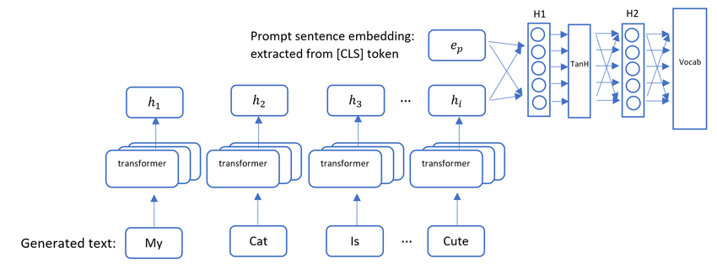
MODELLING

Slide 10
RESULTS:
TextGen achieves impressive results in generating realistic text across various genres, as demonstrated by qualitative evaluation and user feedback.
Users report high satisfaction with the quality and relevance of the generated content, indicating the system's effectiveness in meeting their needs.
Quantitative metrics, such as perplexity scores or BLEU scores, can also be used to assess the performance of the model and compare it with baseline approaches.

